Slide 1
The CIDOC CRM, a Standard for the
Integration of Cultural Information
Martin Doerr, Stephen Stead
CIDOC Conceptual Reference Model Special Interest Group
Imperial College, London, UK
May 22, 2009

Slide 2
The CIDOC CRM
Outline
Problem statement – information diversity
Motivation example – the Yalta Conference
The goal and form of the CIDOC CRM
Presentation of contents
About using the CIDOC CRM
State of development
Conclusion

Slide 3
The CIDOC CRM
Cultural Diversity and Data Standards
Cultural information is more than a domain:
  Collection description (art, archeology, natural history….)
  Archives and literature (records, treaties, letters, artful works..)
  Administration, preservation, conservation of material heritage
  Science and scholarship – investigation, interpretation
  Presentation – exhibition making, teaching, publication
But how to make a documentation standard?
  Each aspect needs its methods, forms, communication means
  Data overlap, but do not fit in one schema
  Understanding lives from relationships, but how to express them?

Slide 4
The CIDOC CRM
Historical Archives….
Type: Text
Title: Protocol of Proceedings of Crimea Conference
Title.Subtitle: II. Declaration of Liberated Europe
Date: February 11, 1945
Creator: The Premier of the Union of Soviet Socialist Republics
The Prime Minister of the United Kingdom
The President of the United States of America
Publisher: State Department
Subject: Postwar division of Europe and Japan
Metadata
Documents
“The following declaration has been approved:
The Premier of the Union of Soviet Socialist Republics,
the Prime Minister of the United Kingdom and the President
of the United States of America have consulted with each
other in the common interests of the people of their countries
and those of liberated Europe. They jointly declare their mutual
agreement to concert…
….and to ensure that Germany will never again be able to
disturb the peace of the world…… “
About…

Slide 5
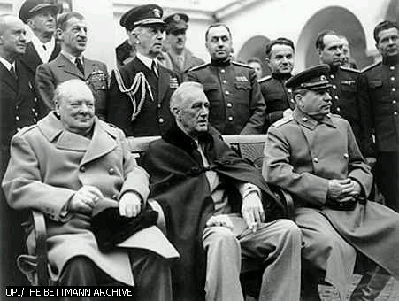
The CIDOC CRM
Images, non-verbose…
Type: Image
Title: Allied Leaders at Yalta
Date: 1945
Publisher: United Press International (UPI)
Source: The Bettmann Archive
Copyright: Corbis
References: Churchill, Roosevelt, Stalin
Photos, Persons
Metadata
About…

Slide 6
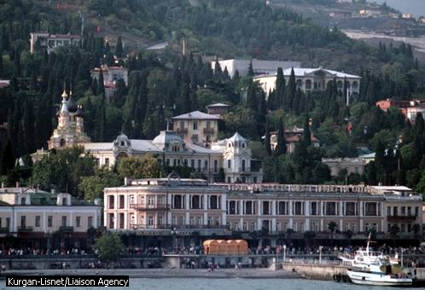
The CIDOC CRM
Places and Objects
TGN Id: 7012124
Names: Yalta (C,V), Jalta (C,V)
Types: inhabited place(C), city (C)
Position: Lat: 44 30 N,Long: 034 10 E
Hierarchy: Europe (continent) <– Ukrayina (nation) <– Krym (autonomous republic)
Note: …Site of conference between Allied powers in WW II in 1945; ….
Source: TGN, Thesaurus of Geographic Names
Places, Objects
About…
Title: Yalta, Crimean Peninsula
Publisher: Kurgan-Lisnet
Source: Liaison Agency

Slide 7
The CIDOC CRM
The Integration Problem (1)
Problem 1- Identity:
  Actors, Roles, proper names:
    The Premier of the Union of Soviet Socialist Republics
    Allied leader, Allied power
    Joseph Stalin….
  Places
    Jalta, Yalta
    Krym, Crimea
  Events
    Crimea Conference, “Allied Leaders at Yalta”,“… conference between Allied powers” “Postwar division”
  Objects and Documents:
    The photo, the agreement text

Slide 8
The CIDOC CRM
The Integration Problem (2)
Problem 2- hidden entities (typically “title”):
  Actors
    Allied leader, Allied power
  Places
    Yalta, Crimea
  Events
    Crimea Conference, “Allied Leaders at Yalta”,“… conference between Allied powers” “Postwar division”
Solution:
  Change metadata structures: but what are the relevant elements?

Slide 9
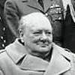
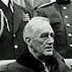
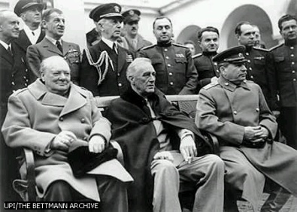
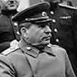
The CIDOC CRM
Explicit Events, Object Identity, Symmetry
E52 Time-Span
E53 Place
E39 Actor
February 1945
7012124
P82 at some time
within
P7 took place at
P11 participated in
E7 Activity
E39 Actor
“Crimea Conference”
E38 Image
P86 falls within
P67 is referred to by
E65 Creation Event
*
E39 Actor
E31 Document
P14 performed
P81 ongoing throughout
P94 has created
“Yalta Agreement”
E52 Time-Span
1945-02-11

Slide 10
The CIDOC CRM…
…captures the underlying semantics of relevant documentation structures in a formal ontology
Ontologies are formalized knowledge: clearly defined concepts and relationships about possible states of affairs in a domain
They can be understood by people and processed by machines to enable data exchange, data integration, query mediation etc.
Semantic interoperability in cultural heritage can be achieved with an “extensible ontology of relationships” and explicit event modeling
This provides shared explanation rather than the prescription of a common data structure
The ontology is the language that S/W developers and museum experts can share. Therefore it needed interdisciplinary work. That is what CIDOC has provided

Slide 11
The CIDOC CRM
Outcomes
The CIDOC Conceptual Reference Model
  A collaboration with the International Council of Museums
  An ontology of 86 classes and 137 properties for culture and more
  With the capacity to explain hundreds of (meta)data formats
  Accepted by ISO TC46 in September 2000
  International standard since 2006 - ISO 21127:2006
Serving as:
  intellectual guide to create schemata, formats, profiles
  A language for analysis of existing sources for integration/mediation
    “Identify elements with common meaning”
  Transportation format for data integration / migration / Internet

Slide 12


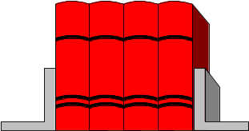
The CIDOC CRM
The Intellectual Role of the CRM
Conceptualization
?
CIDOC
Reference
Model
abstracts from
approximates
explains,
motivates
Data structures &
Presentation models
organize
refer to
Metadata
Data
bases
Legacy
systems
Legacy
systems
World Phenomena
Data in various forms

Slide 13
The CIDOC CRM
Encoding of the CIDOC CRM
The CIDOC CRM is a formal ontology (defined in TELOS)
  But CRM instances can be encoded in many forms: RDBMS, ooDBMS, XML, RDF(S)
  Uses Multiple isA – to achieve uniqueness of properties in the schema
  Uses multiple instantiation – to be able to combine not always valid combinations (e.g. destruction – activity)
  Uses Multiple isA for properties to capture different abstraction of relationships
Methodological aspects:
  Entities are introduced as anchors of properties (and if structurally relevant)
  Frequent joins (short-cuts) of complex data paths for data found in different degrees of detail are modeled explicitly

Slide 14
The CIDOC CRM
Justifying Multiple Inheritance
Single Inheritance form:
Multiple Inheritance form:
Museum Artefact
Museum Artefact
museum number
museum number
collection
collection
material
material
Canister
Ecclesiastical item
Canister
Ecclesiastical item
container
container
lid
belongs to church
lid
belongs to church
Holy Bread Basket
Holy Bread Basket
container
lid
Repetition of properties
Unique identity of properties

Slide 15
The CIDOC CRM
Data example (e.g. from extraction)
Epitaphios GE34604
(entity
E22 Man-Made Object
)
P30 custody transferred through, P24 changed ownership through
Transfer of Epitaphios GE34604
(entity
E10 Transfer of Custody, E8 Acquisition Event
Multiple Instantiation
P28 custody surrendered by
Metropolitan Church of the Greek Community of Ankara
(entity
E39 Actor
)
P23 transferred title from
Metropolitan Church of the Greek Community of Ankara
(entity
E39 Actor
)
P29 custody received by
Museum Benaki
(entity
E39 Actor
)
P22 transferred title to
Exchangeable Fund of Refugees
(entity
P40 Legal Body
)
P2 has type
(entity
E55 Type
)
national foundation
P14 carried out by
Exchangeable Fund of Refugees
(entity
E39 Actor
)
P4 has time-span
GE34604_transfer_time
(entity
E52 Time-Span
)
P82 at some time within
(entity
E61 Time Primitive
)
1923 - 1928
P7 took place at
Greece
(entity
E53 Place
)
P2 has type
(entity
E55 Type
)
nation
TGN data
republic
(entity
E55 Type
)
P89 falls within
Europe
(entity
E53 Place
)
P2 has type
continent
(entity
E55 Type
)

Slide 16
The CIDOC CRM
Top-level classes useful for integration
E55 Types
refer to / refine
E41 Appellations
E39 Actors
E28 Conceptual Objects
refer to / identify
E18 Physical Thing
participate in
affect or / refer to
location
E2 Temporal Entities
E52 Time-Spans
within
at
E53 Places

Slide 17
The CIDOC CRM
The types of relationships
  Identification of real world items by real world names
  Observation and Classification of real world items
  Part-decomposition and structural properties of Conceptual & Physical Objects, Periods, Actors, Places and Times
  Participation of persistent items in temporal entities
    creates a notion of history: “world-lines” meeting in space-time
  Location of periods in space-time and physical objects in space
  Influence of objects on activities and products and vice-versa
  Reference of information objects to any real-world item

Slide 18
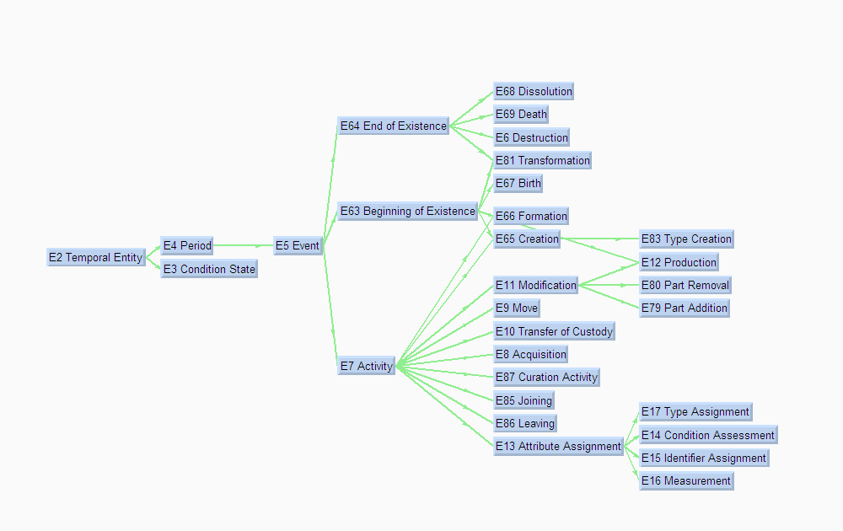
The CIDOC CRM
The E2 Temporal Entity Hierarchy

Slide 19
The CIDOC CRM
Scope note example: E2 Temporal Entity
E2 Temporal Entity
  Scope Note:
  This class comprises all phenomena, such as the instances of E4 Periods, E5 Events and states, which happen over a limited extent in time.
  In some contexts, these are also called perdurants. This class is disjoint from E77 Persistent Item. This is an abstract class and has no direct instances. E2 Temporal Entity is specialized into E4 Period, which applies to a particular geographic area (defined with a greater or lesser degree of precision), and E3 Condition State, which applies to instances of E18 Physical Thing.
    Is limited in time, is the only link to time, but is not time itself
    spreads out over a place or object
    the core of a model of physical history, open for unlimited specialisation

Slide 20
The CIDOC CRM
Temporal Entity- Subclasses
E4 Period
  binds together related phenomena
  introduces inclusion topologies - parts etc.
  Is confined in space and time
  the basic unit for temporal-spatial reasoning
E5 Event
  looks at the input and the outcome
  introduces participation of people and presence of things
  the basic unit for weak causal reasoning
  each event is a period if we study the process
E7 Activity
  adds intention, influence and purpose
  adds tools

Slide 21
The CIDOC CRM
Temporal Entity- Main Properties
E2 Temporal Entity
  Properties: P4 has time-span (is time-span of): E52 Time-Span
E4 Period
  Properties: P7 took place at (witnessed): E53 Place
    P9 consists of (forms part of): E4 Period
    P10 falls within (contains): E4 Period
E5 Event
  Properties: P11 had participant (participated in): E39 Actor
  P12 occurred in the presence of (was present at): E77 Persistent Item
E7 Activity
  Properties: P14 carried out by (performed): E39 Actor
    P20 had specific purpose (was purpose of): E5 Event
    P21 had general purpose (was purpose of): E55 Type

Slide 22
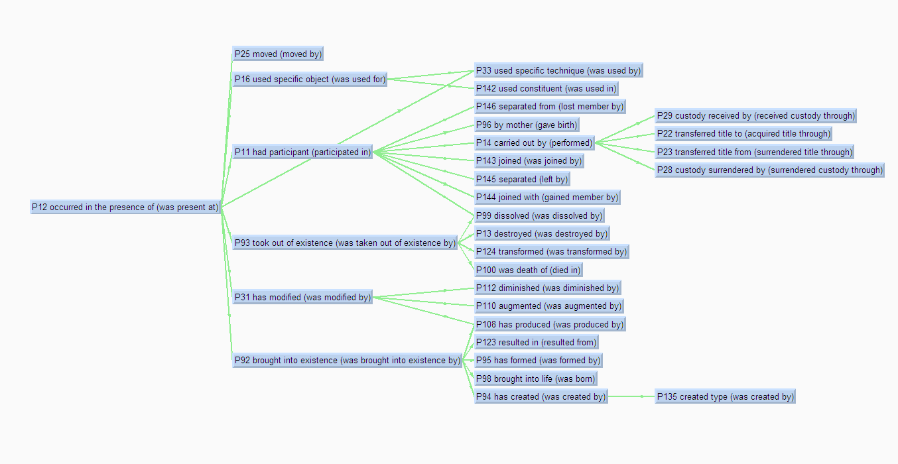
The CIDOC CRM
The Participation Properties

Slide 23
The CIDOC CRM
Termini postquem / antequem
P82 at some time
within
AD461
*
*
P82 at some time
within
AD453
P4 has time-span
(is time-span of)
P4 has time-span
(is time-span of)
Death of
Leo I
Death of
Attila
P11 had participant:
P93 took o.o.existence:
P82 at some time
within
P92 brought i. existence:
P100 was death of
(died in)
*
AD452
P100 was death of
(died in)
before
P4 has time-span
(is time- span of)
before
P14 carried out by
(performed)
Attila
meeting
Leo I
P14 carried out by
(performed)
Pope Leo I
Attila
before
before
P98 brought into life
(was born)
P98 brought into life
(was born)
Birth of
Leo I
Birth of
Attila
Deduction:
before

Slide 24
The CIDOC CRM
Historical events as meetings
t
Brutus
coherence volume of Caesar’s death
Caesar’s mother
Caesar
Brutus’ dagger
coherence volume of Caesar’s birth
S

Slide 25
The CIDOC CRM
Depositional events as meetings
t
lava and
ruins
ancient
Santorinian
coherence volume of volcano eruption
house
volcano
coherence volume of house building
S
Santorini - Akrotiti

Slide 26
The CIDOC CRM
Exchanges of information as meetings
t
Victory!!!
coherence volume of second announcement
coherence volume of first announcement
2nd Athenian
Victory!!!
1st Athenian
other
Soldiers
runner
coherence volume of the battle of Marathon
Marathon
Athens
S

Slide 27
The CIDOC CRM
Time Uncertainty, Certainty and Duration
P81 ongoing
throughout
before
Duration (P83,P84)
after
“intensity”
Event
time
P82 at some
time within

Slide 28
The CIDOC CRM
E52 Time-Span
E1 CRM Entity
0,n
P1 is identified by
(identifies)
P86 falls with in
(contains)
0,n
P81 ongoing throughout
0,n
0,n
E2 Temporal Entity
P4 has time-span
(is time-span of)
E52 Time-Span
1,1
E61 Time Primitive
1,1
1,n
1,1
0,n
0,n
E53 Place
P82 at some time within
E77 Persistent Item
P78 is identified by
(identifies)
0,n
P7 took place at
(witnessed)
P5 consists of
(forms part of)
P9 consists of
(forms part of)
0,n
0,n
E41 Appellation
0,1
E3 Condition State
0,n
0,1
1,n
E4 Period
0,n
0,n
0,n
E44 Time Appellation
P10 falls with in
(contains)
E5 Event
E50 Date

Slide 29
The CIDOC CRM
E7 Activity and inherited properties
E59 Primitive Value
0,1
P3 has note
0,n
0,n
E62 String
E1 CRM Entity
P3.1 has type
P2 has type
(is type of)
E55 Type
0,n
E5 Event
E55 Type
E.g., “Field Collection”
E55 Type
E.g., “photographer”
P14.1 in the role of
0,n
P14 carried out by
(performed)
1,n
E7 Activity
E39 Actor

Slide 30
The CIDOC CRM
Activities: E16 Measurement
0,n
0,n
0,n
0,n
P140 assigned attribute to
(was attribute by)
E13 Attribute Assignment
P141 assigned
(was assigned by)
E1 CRM Entity
E1 CRM Entity
E70 Thing
P39 measured
(was measured by)
E16 Measurement
P40 observed dimension
(was observed in)
E54 Dimension
0,n
1,1
1,n
0,n
0,n
1,1
1,1
1,1
P43 has dimension
(is dimension of)
P91 has unit
(is unit of)
P90 has value
Shortcut
0,n
0,n
E58 Measurement Unit
E60 Number

Slide 31
The CIDOC CRM
Activities: E14 Condition Assessment
P2 has type
(is type of)
E1 CRM Entity
0,n
An Assessment may
include many different sub-activities
E2 Temporal Entity
0,n
0,n
1,n
E55 Type
E39 Actor
P14 carried out by
(performed)
E7 Activity
P14.1 in the role of
P34 concerned
(was assessed by)
1,n
1,n
P35 has identified
(identified by)
E14 Condition Assessment
0,n
0,n
E18 Physical Thing
0,n
P44 has condition
(condition of)
1,1
E3 Condition State
Condition State is a Situation.
Its type is the “condition”

Slide 32
The CIDOC CRM
Activities: E8 Acquisition
0,1
P3 has note
0,n
0,n
P2 has type
(is type of)
0,n
E62 String
E1 CRM Entity
E55 Type
P3.1 has type
E55 Type
E5 Event
No buying and selling,
just one transfer
P14.1 in the role of
P14 carried out by
(performed)
1,n
E7 Activity
P22 transferred title to
(acquired title through)
0,n
1,n
P24 transferred title of
(changed ownership through)
E8 Acquisition
P23 transferred title from
(surrendered title through)
0,n
0,n
0,n
0,n
P51 has former or current owner
(is former or current owner of)
0,n
0,n
0,n
E39 Actor
E18 Physical Thing
0,n
P52 has current owner
(is current owner of)
0,n

Slide 33
The CIDOC CRM
Activities: E9 Move
P7 took place at
(witnessed)
1,n
E5 Period
P20 had specific purpose
(was purpose of)
0,n
0,n
0,n
E7 Activity
P21 had general purpose
(was purpose of)
E55 Type
0,n
P26 moved to
(was destination of)
1,n
1,n
P25 moved
(moved by)
E9 Move
P27 moved from
(was origin of)
1,n
P53 has former or current location
(is former or current location of)
1,n
E18 Physical Thing
0,n
0,n
0,n
0,n
0,n
E53 Place
0,n
P55 has current location
(currently holds)
0,1
E19 Physical Object
0,n
0,1
P54 has current permanent location
(is current permanent location of)

Slide 34
The CIDOC CRM
Activities: E11 Modification/ E12 Production
1,n
P14 carried out by
(performed)
0,n
E7 Activity
E39 Actor
P14.1 in the role of
0,n
E11 Modification
0,n
P32 used general technique
(was technique of)
0,n
E55 Type
1,n
E18 Physical Thing
0,n
Things may be
different from
their plans
1,n
E12 Production
1,n
P45 co nsists of
(is incor porated in)
P31 has modified
(was mod ified by)
P108 has produced
(was produ ced by)
P33 used specific technique
(was used by)
0,n
1,1
P69 is associated with
0,n
E24 Physical Man-Made Thing
0,n
0,n
0,n
0,n
P68 usually employs
(is usually employed by)
0,n
Materials
may be lost
or altered
E29 Design or Procedure
E57 Material
P126 employed
(was employed in)
0,n

Slide 35
The CIDOC CRM
Inheriting Properties: E11 Modification
Properties:
P1 is identified by (identifies): E41 Appellation
P2 has type (is type of): E55 Type
P11 had participant (participated in): E39 Actor
P14 carried out by (performed): E39 Actor
(P14.1 in the role of : E55 Type)
P31 has modified (was modified by): E24 Physical Man-Made Thing
P12 occurred in the presence of (was present at): E77 Persistent Item
P16 used specific object (was used for): E70 Thing
(P16.1 mode of use: E55 Type)
P32 used general technique (was technique of): E55 Type
P33 used specific technique (was used by): E29 Design or Procedure
P17 was motivated by (motivated): E1 CRM Entity
P19 was intended use of (was made for): E71 Man-Made Thing
(P19.1 mode of use: E55 Type)
P20 had specific purpose (was purpose of): E5 Event
P21 had general purpose (was purpose of): E55 Type
P126 employed (was employed in): E57 Material
inherited properties
declared property
inherited properties
declared properties
inherited properties
declared property

Slide 36
The CIDOC CRM
Ways of Changing Things
E64 End of Existence
E63 Beginning of Existence
P92 brought into existence
(was brought into existence by)
P123 resulted in
(resulted from)
P93 took out of existence
(was taken o.o.e. by)
E81 Transformation
E77 Persistent Item
P31 has modified
(was modified by)
P124 transformed
(was transformed by)
E11 Modification
E79 Part Addition
P111 added
(was added by)
E18 Physical Thing
P113 removed
(was removed by)
P110 augmented
(was augmented by)
E80 Part Removal
P112 diminished
(was diminished by)
E24 Ph. M.-Made Thing

Slide 37
The CIDOC CRM
Taxonomic discourse
E7 Activity
E1 CRM Entity
E65 Creation Event
P94 has created
(was created by)
P136 was based on
(supported type creation)
E28 Conceptual Object
E83 Type Creation
P137 is exemplified
by (exemplifies)
P41 classified
(was classified by)
P135 created type
(was created by)
E17 Type Assignment
P42 assigned
(was assigned by)
E55 Type
P136.1 in the
taxonomic role
P137.1 in the
taxonomic role

Slide 38
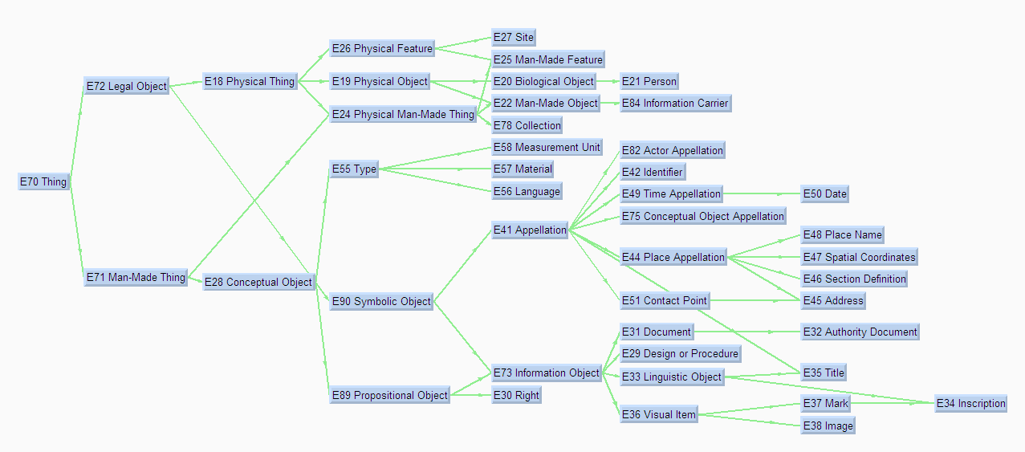
The CIDOC CRM
E70 Thing
material
immaterial

Slide 39
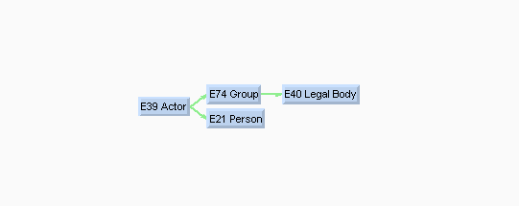
The CIDOC CRM
E39 Actor

Slide 40
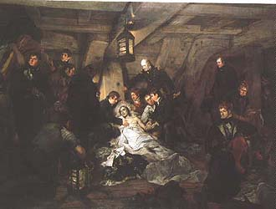
The CIDOC CRM
E53 Place
E53 Place
  A place is an extent in space, determined diachronically with regard to a larger, persistent constellation of matter, often continents -
    by coordinates, geophysical features, artefacts, communities, political systems, objects - but not identical to
  A “CRM Place” is not a landscape, not a seat - it is an abstraction from temporal changes - “the place where…”
  A means to reason about the “where” in multiple reference systems.
  Examples:
    figures from the bow of a ship
    African dinosaur foot-prints in Portugal
    where Nelson died

Slide 41
The CIDOC CRM
Properties of E53 Place
0,n
P7 took place at
(witnessed)
1,n
0,n
P88 consists of
(forms part of)
0,n
0,n
P26 moved to
(was destination of)
E4 Period
P89 falls within
(contains)
E53 Place
0,n
1,n
E9 Move
0,n
0,n
0,n
P27 moved from
(was origin of)
1,n
0,n
0,n
1,n
P87 is identified by
(identifies)
0,1
E12 Production
0,n
1,n
P53 has former or current location
(is former or current location of )
P25 moved
(moved by)
E44 Place Appellation
P59 has section
(is located on or within)
P108 has produced
(was pro duced by)
0,n
1,n
1,1
0,n
E46 Section Definition
P58 has section definition
(defines section)
E18 Physical Thing
E47 Spatial Coordinates
1,1
0,n
E48 Place Name
E45 Address
E24 Physical Man-Made
Thing
Where was Lord Nelson’s ring
when he died?
E19 Physical Object
P8 took place on or within
(witnessed)
0,n

Slide 42
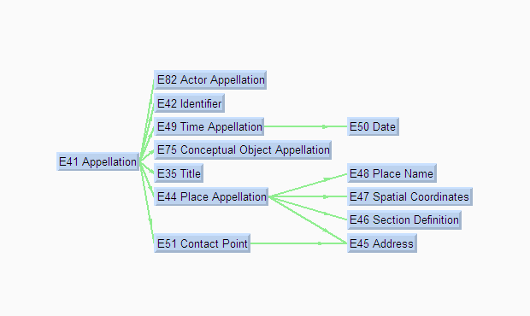
The CIDOC CRM
E41 Appellation

Slide 43
The CIDOC CRM
Extension Example: Getty’s TGN
P89 falls within
E53 Place
P87 is identified by
(identifies)
E44 Place Appellation
E39 Actor
E13 Attribute Assignment
to place
assigns name
P7 took place at
identified by
E74 Group
carries
out
Place Naming
E4 Period
P4 has time-span
to community
E52 Time-Span
P4 has time-span
Community

Slide 44
The CIDOC CRM
Sample of the TGN extension
TGN1001441
P89 falls within
P87 is identified by
(identifies)
Kuyunjik
TGN7017998
P87 is identified by
(identifies)
Nineveh
to place
assigns name
assigns name
P7 took place at
identified by
People of Iraq
carries
out
Nineveh naming
Nineveh naming
P4 has time-span
20th century
to community
1st mill. BC
P4 has time-span
City of Nineveh

Slide 45
The CIDOC CRM
Visual Content and Subject
P62.1 mode of
depiction
E55 Type
P62 depicts
(is depicted by)
E1 CRM Entity
P67 refers to
(is referred to by)
E24 Physical Man-Made Thing
P128 carries
(is carried by)
E73 Information Object
P138.1 mode of
depiction
P65 shows visual item
(is shown by)
P138 represents
(has representation)
E84 Information Carrier
E36 Visual Item
E38 Visual Image

Slide 46
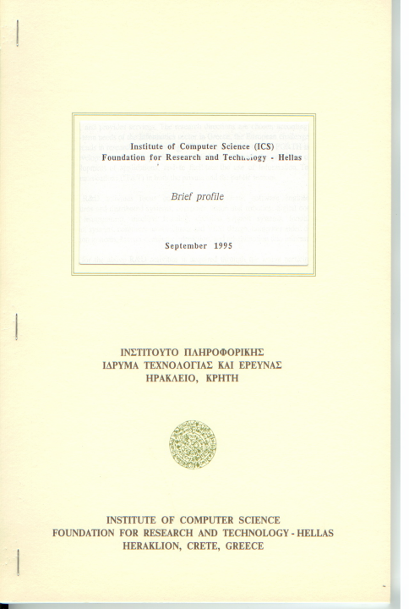
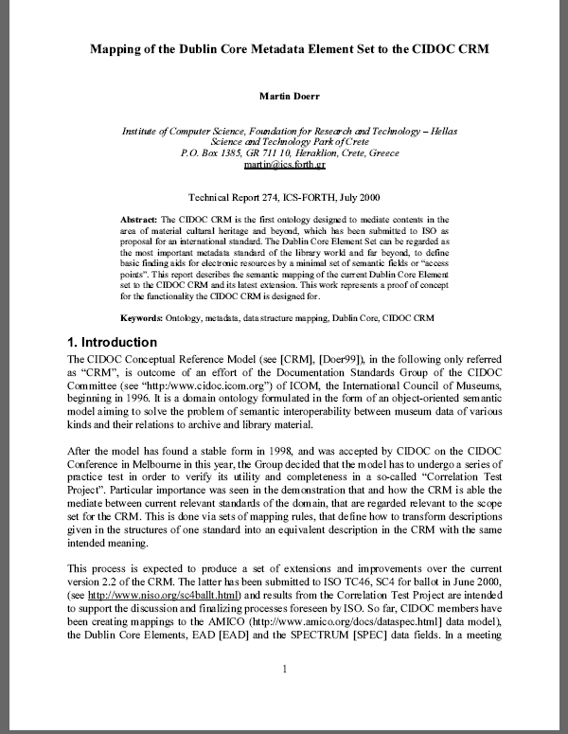
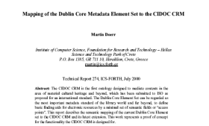
The CIDOC CRM
Application: Mapping DC to the CRM (1)
Example: DC Record about a Technical Report
Type: text
Title: Mapping of the Dublin Core Metadata Element Set to the CIDOC CRM
Creator: Martin Doerr
Publisher: ICS-FORTH
Identifier: FORTH-ICS / TR 274 July 2000
Language: English

Slide 47
The CIDOC CRM
Application: Mapping DC to the CRM (2)
E41 Appellation
Name: Mapping of the Dublin Core Metadata Element Set to the CIDOC CRM
is identified by
E65 Creation
carried
out by
E39 Actor
is identified
by
E82 Actor Appellation
E33 Linguistic Object
was created by
Actor:0001
Event: 0001
Name: Martin Doerr
Object: FORTH-ICS / TR-274 July 2000
was used for
E7 Activity
carried out by
E39 Actor
is identified
by
E82 Actor Appellation
Event: 0002
Actor:0002
Name: ICS-FORTH
has type
E55 Type
is identified by
Type: Publication
has language
E75 Conceptual Object Appellation
has type
E55 Type
Name: FORTH-ICS / TR-274 July 2000
Type:FORTH Identifier
E56 Language
(background knowledge
not in the DC record)
Lang.: English

Slide 48
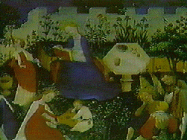
The CIDOC CRM
Application: Mapping DC to the CRM (3)
Example: DC Record about a painting
Type.DCT1: image
Type: painting
Title: Garden of Paradise
Creator: Master of the Paradise Garden
Publisher: Staedelsches Kunstinstitut

Slide 49
The CIDOC CRM
Application: Mapping DC to the CRM (4)
E41 Appellation
Name: Garden of Paradise
E82 Actor Appellation
is identified by
is identified by
Name: Master of the
Paradise Garden
was produced by
E12 Production
carried out by
E73 Information Object
Event: 0003
E39 Actor
Object: PA 310-1A??
is documented
in
ULAN: 4162
E31 Document
Docu: 0001
has type
E82 Actor Appellation
is identified by
Name: Staedelsches Kunstinstitut
was created by
E65 Creation
carried out
by
E39 Actor
E55 Type
E55 Type
Event: 0004
Actor: 0003
DCT1: image
AAT: painting
has type
E55 Type
(AAT: background knowledge
not in the DC record)
Type: Publication Creation

Slide 50
The CIDOC CRM
Lessons from mapping experiences
Semantic Interoperability can defined by the capability of mapping
Mapping for epistemic networks is relatively simple:
  Specialist / primary information databases frequently employ a flat schema, reducing complex relationships into simple fields
  Source fields frequently map to composite paths under the CRM, making semantics explicit using a small set of primitives
  Intermediate nodes are postulated or deduced (e.g., “birth” from “person”). They are the hooks for integration with complementary sources
  Cardinality constraints must not be enforced= Alternative or incomplete knowledge
Domain experts easily learn schema mapping
  IT experts may not understand meaning, underestimate it or are bored by it!
Intuitive tools for domain experts needed:
  Separate identifier matching from schema mapping
  Separate terminology mediation from schema mapping

Slide 51
The CIDOC CRM
Differences to other ontologies
Generally: Many ontologies:-
  lack an empirical base
  have a functionally insufficient system of relationships (terminology driven)
  Have a lack of functional specifications
The CRM misses concepts not in the empirical base (e.g., contracts), but detects concepts that are not lexicalized (e.g.”Persistent Item”), because they are functionally required
DOLCE: Lexical base, intuition. Very good theoretically motivated logical description. Foundational relationships. Over specified relationships (e.g. modes of participation). Bad model of space-time. Strong overlap with CRM
BFO: Philosophically motivated. Poor model of relationships. Notion of a precise, deterministic underlying reality. Empirical verification difficult. Strong overlap with CRM
IndeCs, ABC Harmony: Small ontologies, event centric, strong overlap with CRM (harmonized!)
SUMO: Large aggregation of concepts without functional specifications

Slide 52

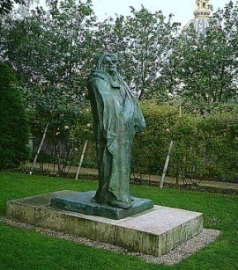
The CIDOC CRM
Applications: Integration with CRM Core (1)
E84 Information Carrier
P62 depicts
E21 Person
The “Monument to Balzac”(S1296)
Honoré de Balzac
P62 depicts
P16B was used for
E84 Information Carrier
P108B was
produced by
The “Monument to Balzac” (plaster)
E12 Production
P134 continued
P108B was
produced by
P2 has type
Bronze casting“Monument to Balzac” in 1925
P2 has type
P4 has time-span
P120B occurs
after
E55 Type
E55 Type
plaster
bronze
E52 Time-Span
1925
P14 carried out by
E12 Production
P7 took
place at
P14 carried out by
E52 Time-Span
E40 Legal Body
Rodin making “Monument to Balzac” in 1898
1917
Rudier (Vve Alexis) et Fils
P4 has
time-span
P4 has time-span
E69 Death
P2 has type
E55 Type
E52 Time-Span
Rodin’s death
companies
1898
E55 Type
sculptors
P100B died in
P2 has type
E53 Place
P98B was born
E21 Person
France (nation)
Rodin Auguste
E67 Birth
P4 has time
-span
E52 Time-Span
Rodin’s birth
1840

Slide 53
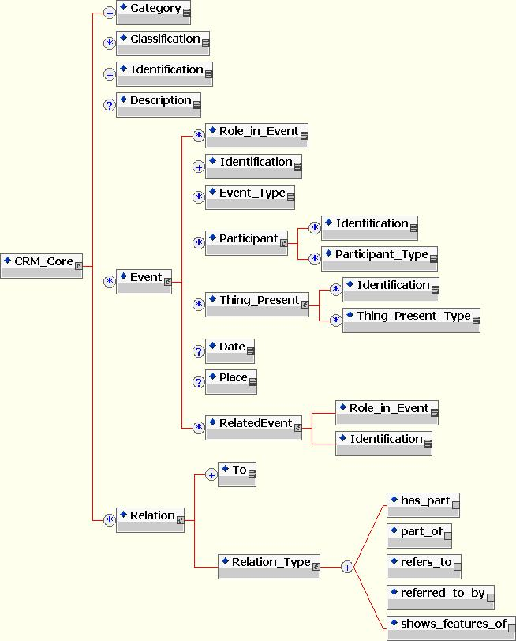
The CIDOC CRM
Applications: Integration with CRM Core (2)

Slide 54
Work (CRM Core).
Category = E84 Information Carrier
Classification =sculpture (visual work)
Classification =plaster
Identification =The Monument to Balzac (plaster)
Description =Commissioned to honor one of France's greatest novelists, Rodin spent seven years preparing for Monument to Balzac. When the plaster original was exhibited in Paris in 1898, it was widely attacked. Rodin retired the plaster model to his home in the Paris suburbs. It was not cast in bronze until years after his death.
Event
Role in Event =P108B was produced by
Identification= Rodin making Monument to Balzac in 1898
Event Type = E12 Production
Participant
Identification =Rodin, Auguste
Identification =ID: 500016619
Participant Type = artists
Participant Type = sculptors
Date = 1898
Place = France (nation)
Related event
Role in Event =P134B was continued by
Identification= Bronze casting Monument to Balzac in 1925
Event
Role in Event =P16B was used for
Identification= Bronze casting Monument to Balzac in 1925
Event Type = E12 Production
Participant
Identification =Rudier (Vve Alexis) et Fils
Participant Type = companies
Thing Present
Identification =The Monument to Balzac (S.1296)
Thing Present Type =bronze
Thing Present Type =sculpture (visual work)
Date = 1925
Related event
Role in Event =P120B occurs after
Identification= Rodin's death
Relation
To = Honore de Balzac
Relation type
refers to
CRM Core
A minimal metadata element set
Artist (CRM Core).
Category = E21 Person
Classification = artists
Classification = sculptors
Identification =Rodin, Auguste
Identification =ID: 500016619
Event
Role in Event =P98B was born
Identification= Rodin‘s birth
Event Type = E67 Birth
Date = 1840
Event
Role in Event =P100B died in
Identification= Rodin‘s death
Event Type = E69_Death
Date = 1917
Related event
Role in Event =P120 occurs before
Identification= Bronze casting Monument to Balzac in 1925

Slide 55
The CIDOC CRM
Methodological aspects
The CRM aims at semantic integration beyond context.
It aims at pulling together all relevant sources and data to evaluate a scientific or scholarly question not answered by an individual document
Based on the CRM, effective integration schemata can be defined, such as “CRM Core”, the full CRM or extensions of the CRM
The CRM can fit rich and poor models under one common logical frame-work . For instance Dublin Core (DC) maps to the CRM
Idea: Not being prescriptive creates lots of flexibility
  It does not propose what to describe. It allows interpretation of what museums and archives actually describe

Slide 56
The CIDOC CRM
Documents and Knowledge
Scientific and scholarly work produces knowledge by argumentation
  This comes in closed units, “documents”
  They have a history of evolution, “versions”
  The knowledge is “directed”
  It can only be evaluated in context
    document about Mona Lisa
    theory about the origin of the Minoan people
It should be possible to map primary document structures to the CRM. This is easy:
  E.g. good is: “creator - creation place - creation date” bad is : “provenance”, “place associations - life-cycle dates” etc.
  Good document structures map easily
  No completeness requirements

Slide 57
The CIDOC CRM
Knowledge management
Three-level knowledge management:
  Acquisition (can be motivated by the CRM):
    sequence and order, completeness, constraints to guide and control data entry.
    ergonomic, case-specific language, optimized to specialist needs
    often working on series of analogous items
    Low interoperability needs (capability to be mapped!)
  Integration / comprehension (target of the CRM):
    break up document boundaries, relate facts to wider context
    match shared identifiers of items, aggregate alternatives
    no preference direction of search, no cardinality constraints
    High interoperability needs (mapping to a global schema)
  Presentation, story-telling (can be based on CRM)
    explore context, paths, analogies orthogonal to data acquisition
    present in order, allow for digestion
    deduction and induction

Slide 58
        The CIDOC CRM -Application
        Repository Indexing
Core level
CIDOC
CRM
Detail level
extension level
Thesauri
extent
CRM entities
Actors
Events
Objects
Background
knowledge /
Authorities
extracted
knowledge
data (e.g. RDF)
Sources
and
metadata
(XML/RDF)

Slide 59
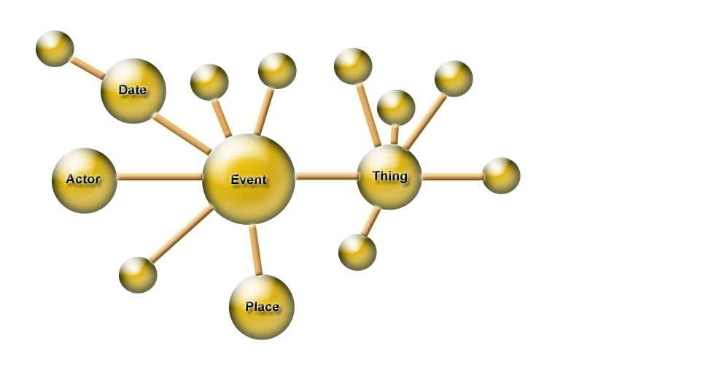
        The CIDOC CRM
        Documents and Factual Knowledge
Linking documents
by co-reference
Primary link
extracted from
one document
CRM Core
Deductions
Integration of
Factual Relations
Johanson's Expedition
Discovery of Lucy
AL 288-1
Donald Johanson
Lucy
Cleveland Museum
of Natural History
Ethiopia
Hadar
Document
Digital Library

Slide 60
The CIDOC CRM
Benefits of the CRM (From Tony Gill)
Elegant and simple compared to comparable Entity-Relationship models
Coherently integrates information at varying degrees of detail
Readily extensible through O-O class typing and specializations
Richer semantic content; allows inferences to be made from underspecified data elements
Designed for mediation of cultural heritage information

Slide 61
The CIDOC CRM
State of Development
Publication as ISO 21127:2006 in October 2006
Work on extension covering FRBR, FRAD and CRM resulted in “FRBR_{OO}”, accepted by IFLA and CIDOC
Ongoing work on TEI – CRM harmonization
Application models (CRM Core, good and rich data exchange formats, extensions)
OWL version being finalized

Slide 62
The CIDOC CRM
Conclusions
Doing all that, we encounter a surprise compared with common preconceptions:
  Nearly no domain specificity (e.g.“current permanent location”), generic concepts appear in medicine, biodiversity etc.
  Rather a notion of scientific method emerges, such as “retrospective analysis”, “taxonomic discourse” etc.
  Extraordinary small set of concepts
  Extraordinary convergence: adding dozens of new formats hardly introduces any new concept
This approach is economic, investment pays off
  The CRM should become our language for semantic interoperability,

